Slide 1


SATs Workshop
3rd October 2025

Slide 2



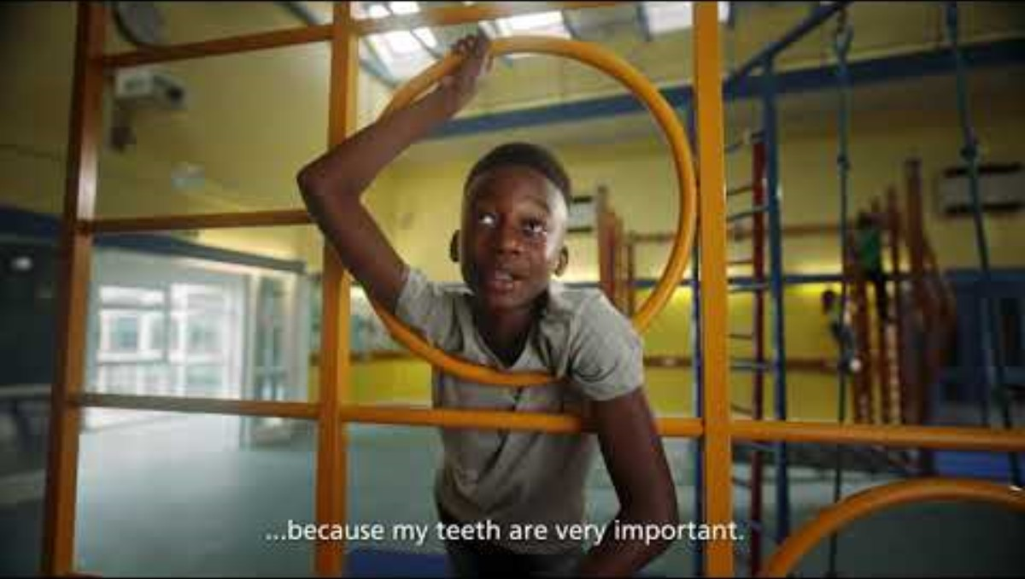
Internet Safety
For many of us we see our online lives and offline lives as different, but children are growing up with technology and there isn’t a difference. Online life and offline life are just life.
Keeping your child safe online
The greatest tool to keep your children safe online is to talk to them about potential risks and how they are protected to stay safe online.
Watch out for our Wake Up Wednesday Facebook posts about keeping safe online

Slide 3
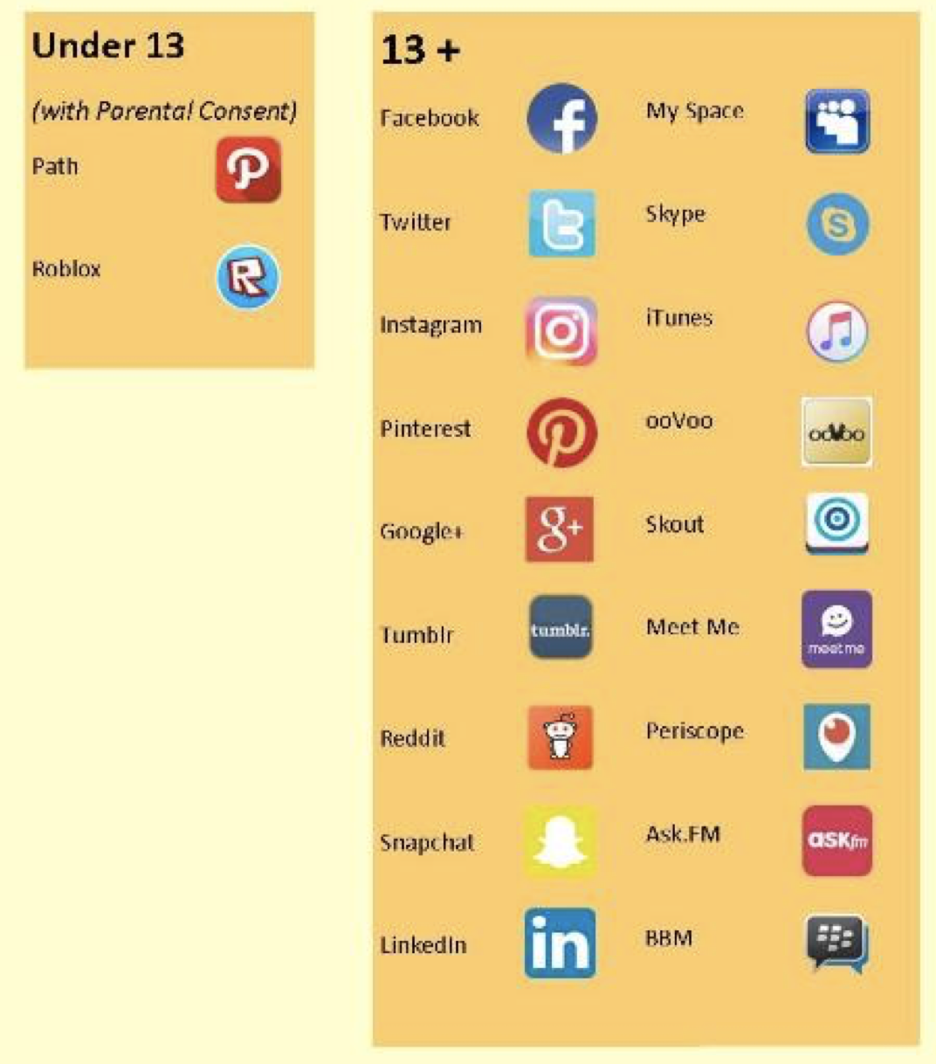
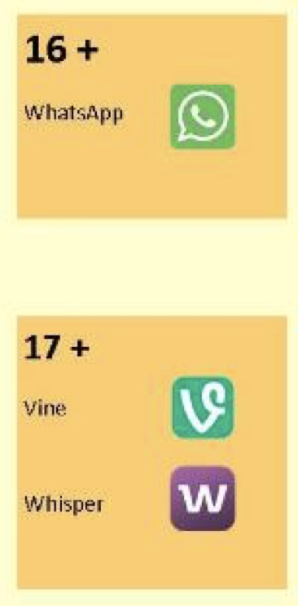
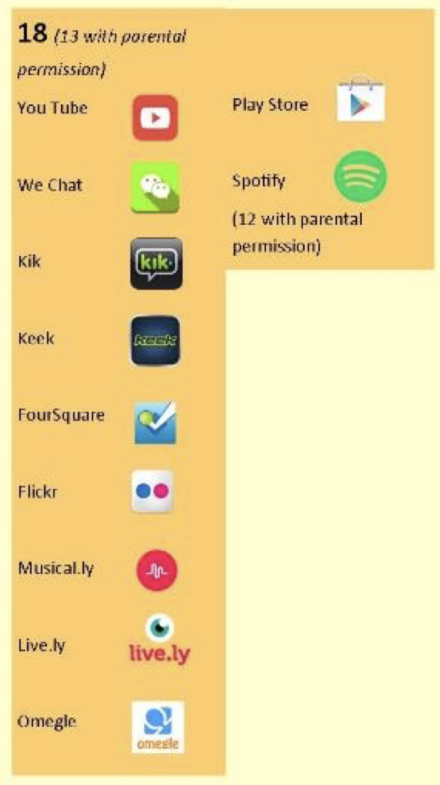
Social Media

Slide 4

Support for Parents

Slide 5
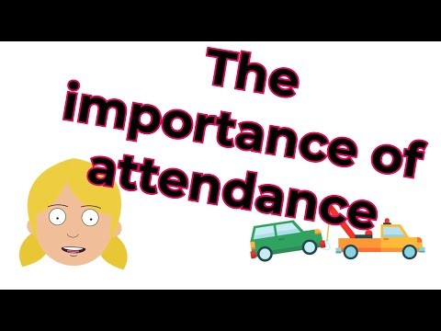
Attendance
Why is it important?
Regular school attendance is an important part of giving children the best possible start in life.
Pupils who have missed more than 10% of school sessions are considered persistently absent.
Attendance at school is crucial to prepare young people for successful transition to adulthood, and to support their longer term economic and social participation in society.

Slide 6


Slide 7
General Expectations in Year 6
Homework is set weekly on a Friday and needs to be returned by Wednesday the following week.
It is expected that children will use Spelling Shed and Times Tables Rockstars at home to practise their weekly spellings and times tables knowledge.
Children need to read as much as possible, but we would like to see at least four entries in their reading records each week.

Slide 8
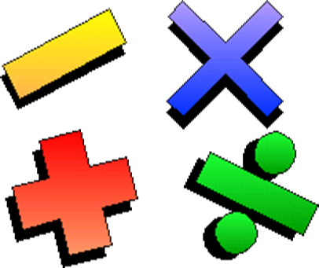

Our aims
To demonstrate some simple, yet effective, ways of supporting your children to achieve a deep and meaningful understanding of maths.
To answer your questions about the way
we teach maths at St Aloysius.
To share with you the areas in which your children are assessed in all areas, at the end of Year 6.

Slide 9

Why do we teach maths?
Adults use maths in everyday life:
As part of a chosen career;
When shopping;
Around the house;
Baking;
In banking and paying bills;
When helping children with homework.
We will be discussing what is needed for children to become confident and competent mathematicians, who have a strongly developed ‘sense of number’.

Slide 10
Why we teach what we teach...
In 2013 the government announced plans to overhaul the national curriculum in England.
The main aim was to raise standards, particularly as the UK is slipping down international student assessment league tables. Inspired by what is taught in the world’s most successful school systems, including Hong Kong, Singapore and Finland, as well as in the best UK schools, the 2014 curriculum was designed to produce productive, creative and well educated students.
Notes:
This was due to not enough children being fluent in basic maths skills by the end of KS2 or able to compete with counterparts around the world. Additionally, the children needed to be able to ‘use’ the maths they were learning in everyday situations instead of just in the classroom. An overhaul was decided upon to help schools provide a richer maths experience for your children that met clear aims.

Slide 11
Why we teach what we teach...
What changed?
Five-year-olds are expected to learn to count up to 100 (compared to 20 under the previous curriculum) and learn number bonds to 20
Simple fractions (1/4 and 1/2) are taught from KS1, and by the end of primary school, children should be able to convert decimal fractions to simple fractions (e.g. 0.375 = 3/8)
By the age of nine, children are expected to know times tables up to 12x12 (previously 10x10 by the end of primary school)
Calculators are now not to be used at all in primary schools, to encourage mental arithmetic
Notes:
This was due to not enough children being fluent in basic maths skills by the end of KS2 or able to compete with counterparts around the world. Additionally, the children needed to be able to ‘use’ the maths they were learning in everyday situations instead of just in the classroom. An overhaul was decided upon to help schools provide a richer maths experience for your children that met clear aims.

Slide 12
The aims and purpose of our maths teaching
Become fluent in the fundamentals of mathematics, including through varied and frequent practice with increasingly complex problems over time, so that pupils develop conceptual understanding and the ability to recall and apply knowledge rapidly and accurately.
Reason mathematically by following a line of enquiry, conjecturing relationships and generalisations, and developing an argument, justification or proof using mathematical language
Can solve problems by applying their mathematics to a variety of routine and non-routine problems with increasing sophistication, including breaking down problems into a series of simpler steps and persevering in seeking solutions.
Notes:
Fluency - what this means is that children should have rapid recall of all basic maths skills - times tables, number bonds, estimation, four operations etc. Being able to complete calculations accurately and begin to make links between these is vital for the next stage of learning.
Reasoning mathematically is simply talking about maths and how you know something is correct or incorrect. Again making relationships and applying fluent knowledge to a wider picture (for instance within and outside of actual tables i.e. 3x7=21 so 30x7=210). Asking children to prove what they know develops thinking skills within maths and further secures the basic skills being developed, while using a wide range of mathematical language ensures that pupils have a deeper understanding and knowledge of maths around the world and how it is applied.
Once able to reason about maths and explain how you know or prove a mathematical point then it is possible to problem solve at a higher level, involving many simple or more complex steps. Using a range of tools and resources as required to support pupil understanding and choice around how to approach everyday problems in life.

Slide 13
What do Year 6 children need to know by the end of the year?
Place value
Geometry
Ratio and proportion
Four operations
Measures
Data handling
Fractions, decimals and percentages
Statistics
Algebra
Area and perimeter
Shape

Slide 14
The big ones...
Number: Place Value
Read, write, order and compare numbers up to 10 000 000 and determine the value of each digit.
Round any whole number to a required degree of accuracy.
Use negative numbers in context, and calculate intervals across zero.
Solve number and practical problems that involve all of the above.
Four Operations
Fluently add, subtract, multiply and divide using all formal, written methods (including both long and short division).
Perform mental calculations, involving mixed operations and large numbers.
Identify common factors, common multiples and prime numbers.
Use their knowledge of the order of operations to carry out calculations involving the four operations.
Solve problems involving addition, subtraction, multiplication and division.
Notes:
Numbers are all around and children should be encouraged to read and compare these as part of everyday life-what costs the most? Which temperature is warmer/colder?

Slide 15

Which method should I use?
By the time your children leave St Aloysius they will have been taught mental and written methods that they understand and can use correctly.
Children should be able to decide which method is the most appropriate when faced with a calculation.
There are many ‘correct’ methods used in written calculations and mental maths but we believe that it is more effective for children to learn just a
few and learn them well. Therefore a consist approach to how we teach maths is adopted throughout the school.
Notes:
Discuss doorstep, carrying, borrowing and paying back etc. If I asked you all to answer this calculation now, it is likely that different people would use different methods.

Slide 16
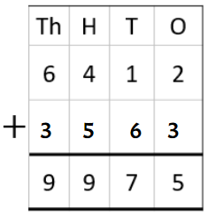
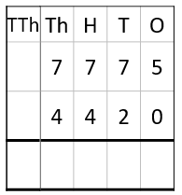

How we use formal methods?
When adding, always start from the ones column.
When the answer is more than 10 in a column, an exchange needs to happen. In this example 10 hundreds have been exchanged for 1 thousand and 10 thousands have been exchanged for 1 ten-thousand.
Don’t forget to add the exchange.
1
1
2
1
9
5
Notes:
Discuss doorstep, carrying, borrowing and paying back etc. If I asked you all to answer this calculation now, it is likely that different people would use different methods.

Slide 17
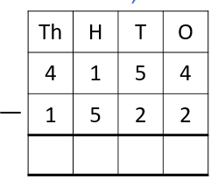
How we use formal methods?
When subtracting, always start from the ones column.
3
1
3
2
3
1
When the first number in the column is smaller than the second, an exchange needs to happen. In this example 1 thousand is exchanged for 10 hundreds.
2
6
3
2
Notes:
Discuss doorstep, carrying, borrowing and paying back etc. If I asked you all to answer this calculation now, it is likely that different people would use different methods.

Slide 18
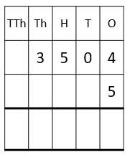
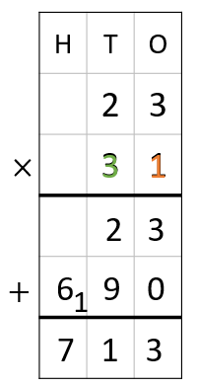


How we use formal methods?
When multiplying, always start from the ones column. Multiply each digit in the 4-digit number by 4. When the answer is 10 or more, an exchange needs to happen. In this example 20 ones have been exchanged for 2 tens, 20 hundreds have been exchanged for 2 thousands and 10 thousands have been exchanged for 1 ten-thousand.
2
2
1
7
5
2
0
When multiplying by a two-digit number, multiply each digit in the number by the ones first then the tens.
In this example (23 x 31), multiply 3 by 1 then 2 by 1. Then multiply by 3 by 3 and 2 by 3. Before multiplying by the tens number insert the 0 in the ones column.
Then add them together.
Notes:
Discuss doorstep, carrying, borrowing and paying back etc. If I asked you all to answer this calculation now, it is likely that different people would use different methods.

Slide 19
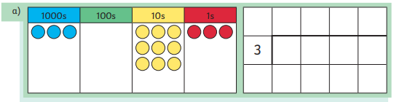
How we use formal methods?
2
1
8
0
r2
When dividing, start from the first column, in this example the thousands column. Divide each digit in the number by 3. If there is a remainder then an exchange needs to happen.
6
5
2
2
4
Notes:
Discuss doorstep, carrying, borrowing and paying back etc. If I asked you all to answer this calculation now, it is likely that different people would use different methods.

Slide 20

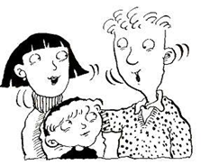
When faced with a calculation problem, encourage your child to ask…
Can I do this in my head?
Could I do this in my head using drawings or jottings to help me?
Do I need to use a written method?
Also, help your child to estimate and then check the answer. Encourage them to ask…Is the answer sensible?
Talk to your child about how they work things out.
Ask your child to explain their thinking/ reasoning.

Slide 21

How do we assess your children?
On a daily basis, through:
Questioning;
Marking and feedback;
Observation;
Knowledge of what the average child needs to do by the end of KS2

Slide 22
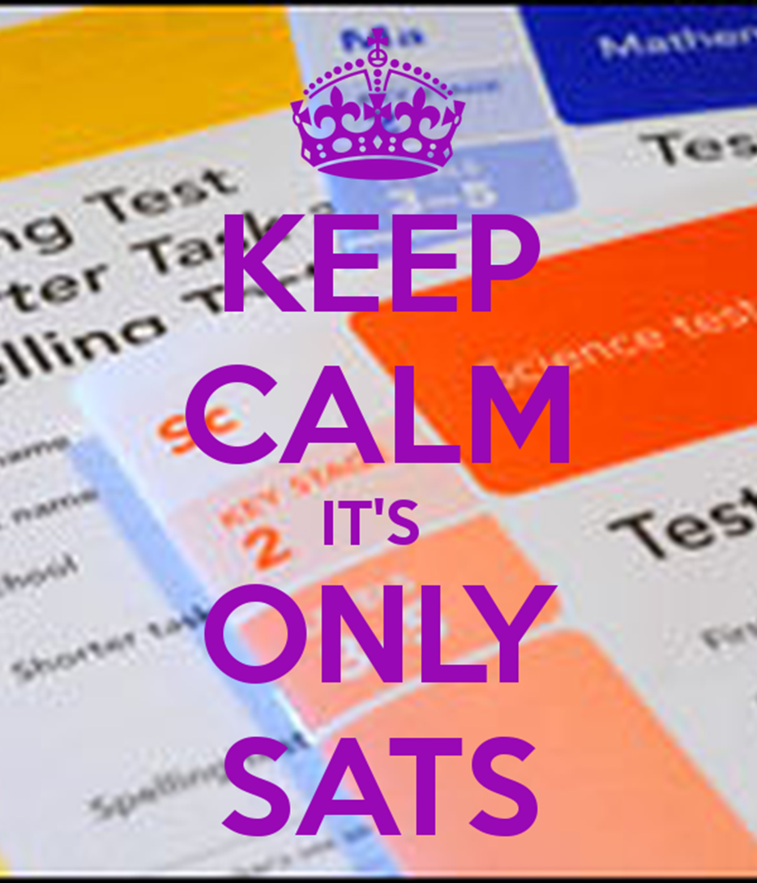

How do we assess your children?
Daily:
Arithmetic practice (Daily 5)
Half termly:
Summative assessments (tests)
End of year - SATs

Slide 23
Maths SATs
The Maths based elements of the SATs tests are divided into three parts;
Arithmetic (Paper 1) - Total Marks 40
(30 mins long)
Reasoning (Papers 2 and 3) - Total marks 35 each (40 mins long)
All scores added to give a total out of 110.

Slide 24
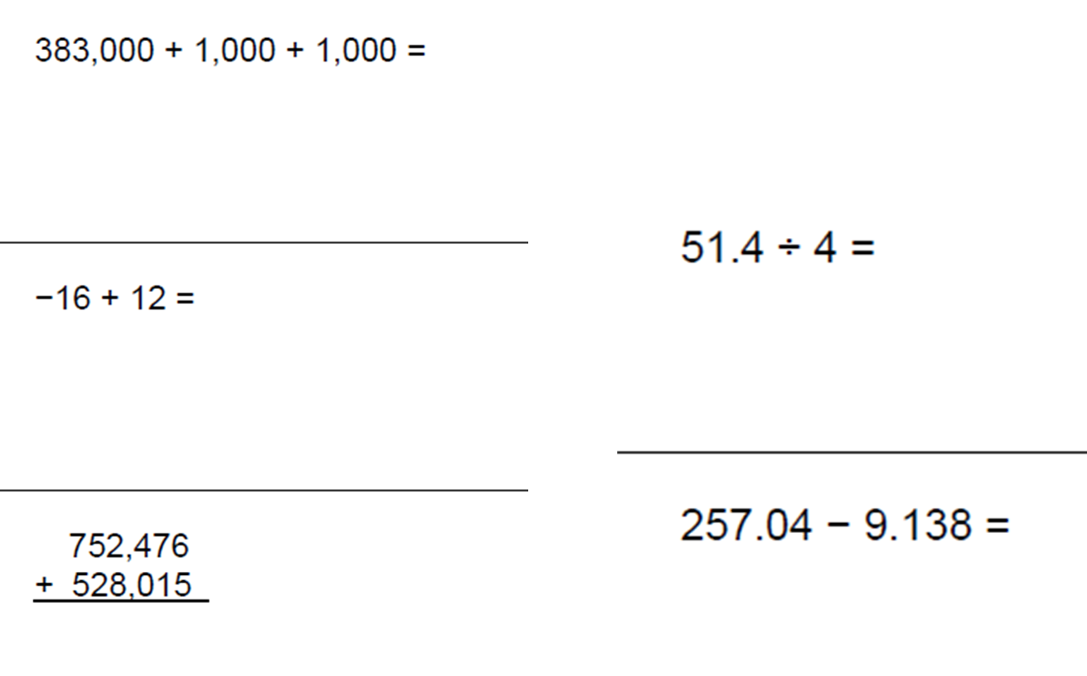
Arithmetic examples

Slide 25
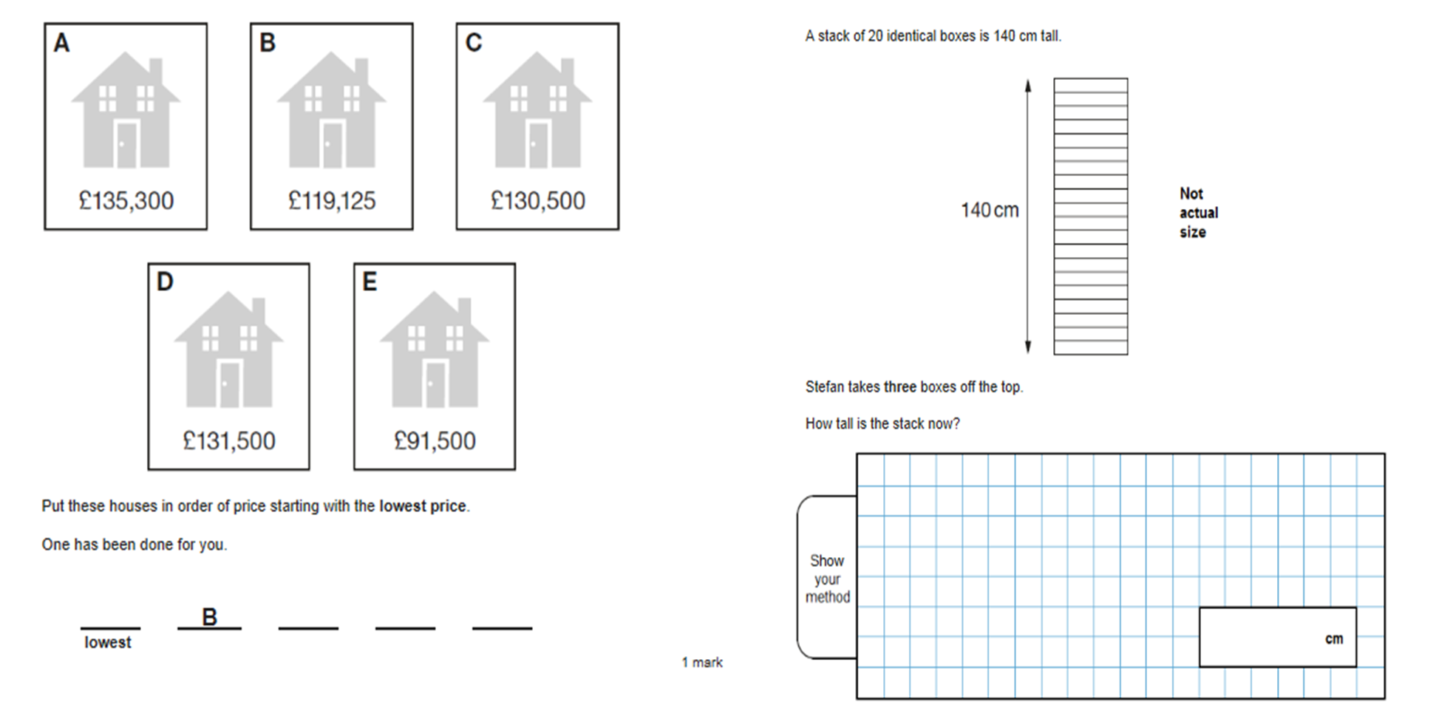
Reasoning examples

Slide 26

Common Errors and Possible Misconceptions
When multiplying by 10 or 100, you just add a zero…
The decimal point can move across the place value columns (the decimal point NEVER MOVES!)
Borrowing and exchanging...
Children switching operation during a calculation…
Not estimating an answer first or checking that it makes sense…

Slide 27
How can you help?
Practising number facts
Find out which number facts your child is learning at school (addition facts to 10, times tables, doubles, etc). Try to practice for a few minutes each day using a range of vocabulary.
Have a ‘fact of the day’. Pin this fact up around the house. Practise reading it in a quiet, loud, squeaky voice. Ask your child if they can recall the fact.
Play ‘tennis’ to practice complements with your child. You say a number. They reply with how much more is needed to make 10. You can also play this game with numbers totaling 20, 100 or 1000. Encourage your child to answer quickly, without counting or using fingers.
Throw 2 dice. Ask your child to find the total of the numbers (+), the difference (-) or the product (x). Can they do this without counting?
·

Slide 28
How can you help?
Practising number facts
Use a set of playing cards (no pictures). Turn over two cards and ask your child to add or multiply the numbers. If they answer correctly they keep the cards. How many cards can they collect in 2 minutes?
Play Bingo. Each player chooses five answers (e.g. numbers to 10 to practice simple addition, multiples of 5 to practice 5 times tables). Ask a question and if a player has the answer they can cross it off. The winner is the first player to cross off all their answers.
Give your child an answer. Ask them to write as many addition sentences as they can with this answer (e.g. 100= ? + ?). Repeat the activity with subtraction or multiplication.
Give your child a number fact (e.g. 75 +25 =100). Ask them what else they can find out from this fact (e.g. 25 +75=100, 100-75=25, 100 - 25 =75, 750+250=1000, 7.5 +2.5 = 10 etc). Add to list over the next few days.
·

Slide 29
How can you help?
Real Life Problems
Go shopping with your child to buy two or three items. Ask them to work out the total amount spent and how much change you will get.
Buy some items with a percentage extra free. Help your child to calculate how much of the product is free.
Plan an outing during the holidays. Ask your child to think about what time you will need to set off and how much money you will need to take.
Use a TV guide. Ask your child to think about the length of their favourite programmes. Can they calculate how long they send watching TV each day/week?
·

Slide 30
How can you help?
Real Life Problems
Use a train or bus timetable. Ask your child to work out how long a journey between two places should take. Go on the journey. Do you arrive earlier or later than expected? How much earlier/later?
Help your child to scale a recipe up or down to feed the right amount of people.
Work together to plan a party or meal within a set budget.
·

Slide 31

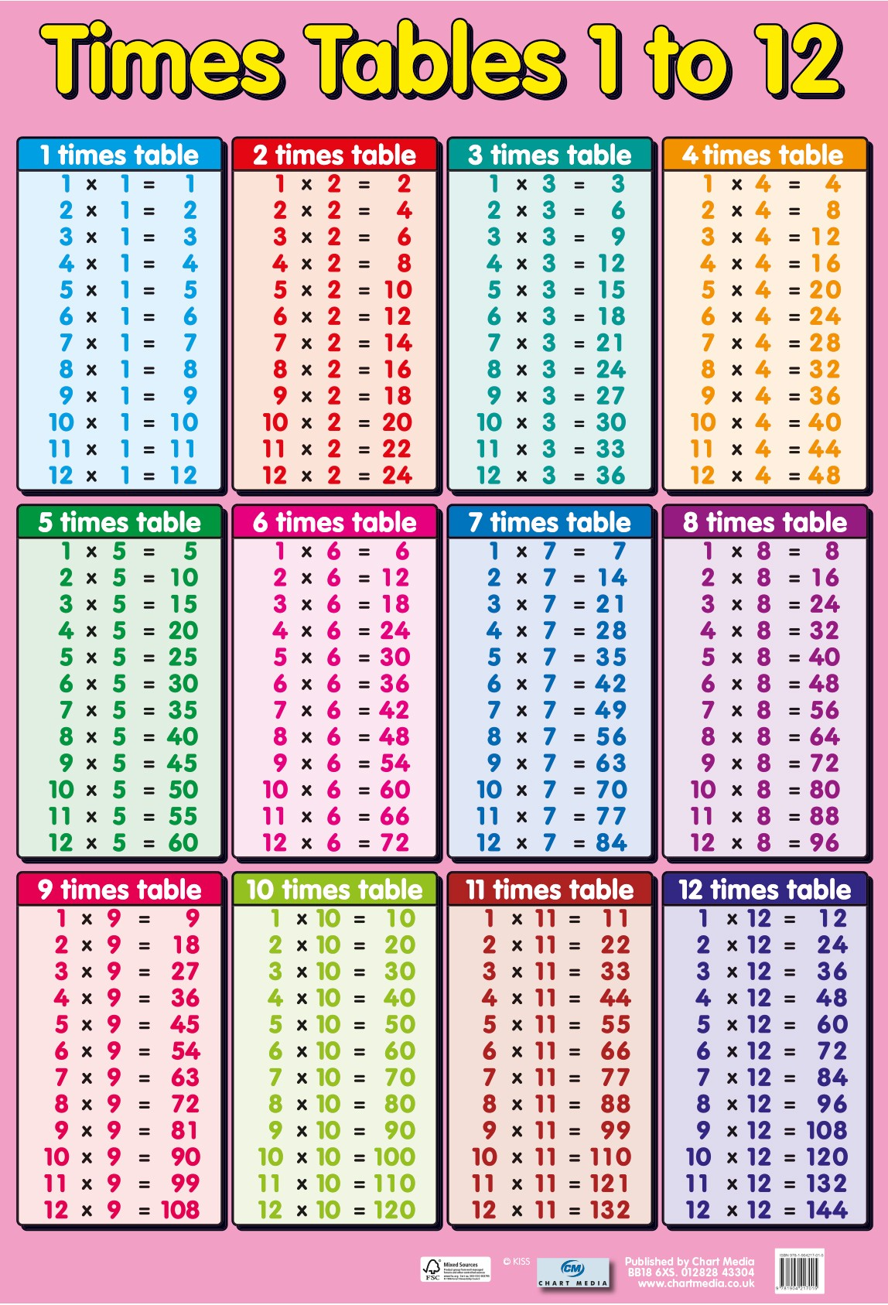

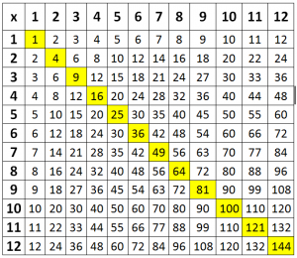

Times tables!!!
Notes:
Discuss how vital they are and show how they come into every branch of mathematics - fractions, measurement etc
Emphasise need to be fluent with rapid recall of all facts - including division facts

Slide 32

English SATs
The English based elements of the SATs tests are divided into two parts;
Reading Paper - Total Marks 50 (1 hour long)
G.P.S (Grammar, punctuation and spelling)
Spelling - Total marks 20
Grammar, punctuation and linguistic features - Total marks 50 (45 minutes long)

Slide 33
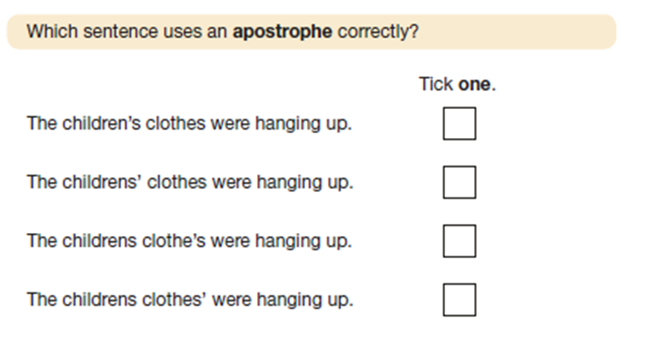
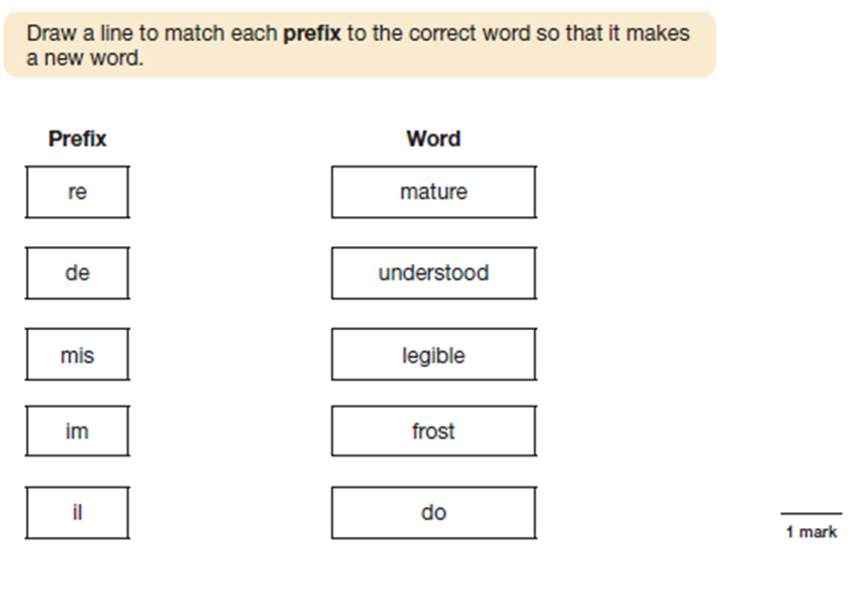
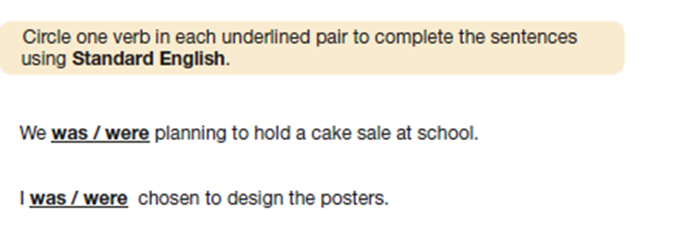
How are the papers divided?
Paper 1 - Grammar, Punctuation and language strategies
Grammar will account for about 30 marks, punctuation will account for about 15 marks and language strategies will account for about 5 marks.

Slide 34
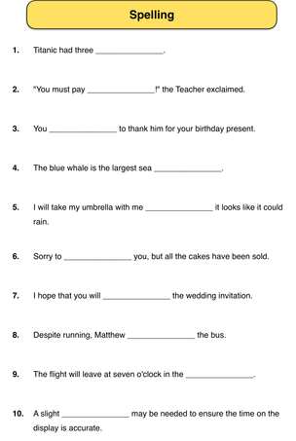

How are the papers divided?
Paper 2 - Spelling
Questions will be sentence based. Pupils will see a sentence with a word missing. The teacher will read the whole sentence including the missing word and will then repeat the missing word. Their task is to fill in the missing word correctly.

Slide 35
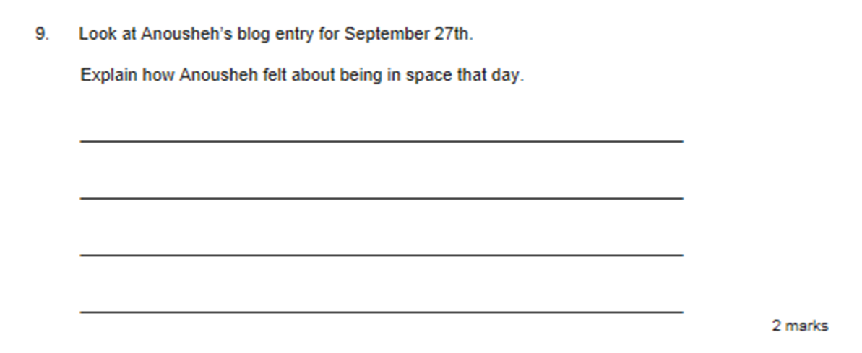
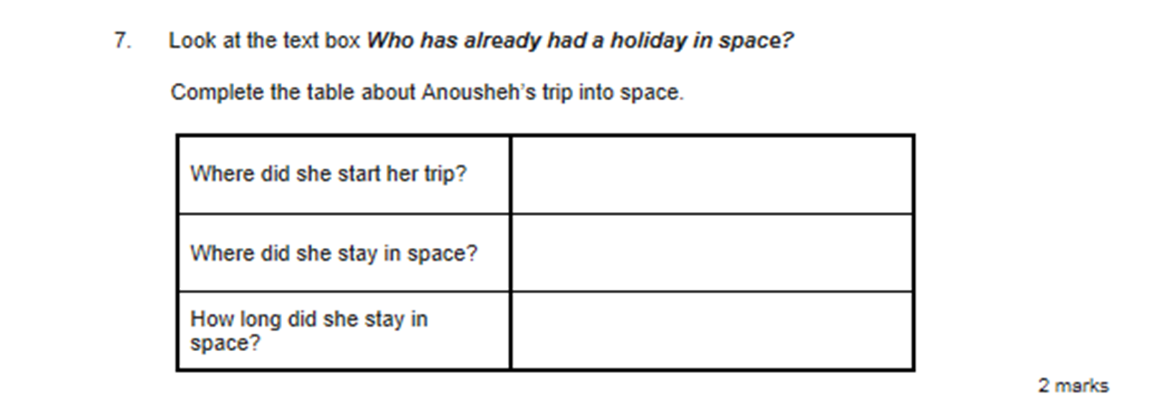
How are the papers divided?
Paper 3 - Reading Comprehension
A series of passages totalling about 2000 words.
Two pieces of fiction/ poetry writing and one piece of non- fiction writing.
Asks a mix of questions including comprehension questions and questions regarding the author’s literary technique and style.

Slide 36
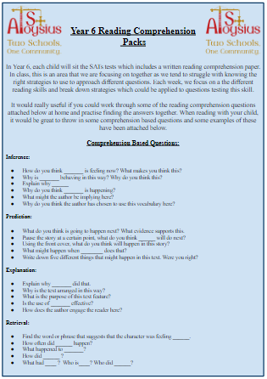
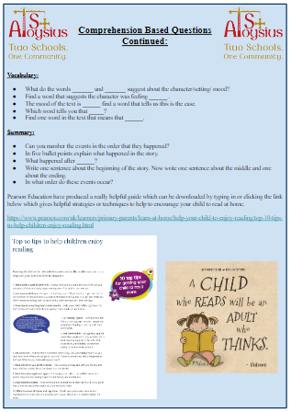

Helping your child prepare
Reading is key throughout primary school to expand your child’s vocabulary. Your child needs a wide vocabulary and the ability to analyse and interpret different types of text, including fiction, non-fiction, poetry and plays. Encouraging Year 6 children to read extensively will prepare them for their end of year tests.

Slide 37
The importance of vocabulary
The Year 6 reading SATs paper is made up of words that the children will have been exposed to across the curriculum throughout their entire schooling life. Often, the SATs papers require the children to pull on their knowledge of vocabulary from Science, History etc. and it is due to this that we have a massive focus on understanding vocabulary across school.
When reading anything, newspapers, brochures signs etc. it would be really beneficial to talk to your child about the meanings of any unknown words and encourage them to read around the word to try to gather implied meaning.

Slide 38
What will help this year?
Completing homework on time
Regular times table practise
Keeping active and eating well
Reading often… and at speed
Having early nights/ being well rested
Having good attendance
Practising spelling words (Y3-Y6)
Being ready to learn each day
Asking for help if needed!

Slide 39
Useful websites
http://www.mathplayground.com/
http://www.teachingtables.co.uk/
http://www.topmarks.co.uk/maths-games/7-11-years/mental-maths
http://www.learn-with-math-games.com/
http://www.primaryresources.co.uk/maths/maths.htm
http://www.bbc.co.uk/education/subjects/z826n39
http://www.helpingwithmath.com/resources/resources.htm
http://www.mad4maths.com/multiplication_table_math_games/
http://www.maths-games.org/times-tables-games.html
http://resources.woodlands.kent.sch.uk/maths/timestable/interactive.htm
http://www.crickweb.co.uk/ks2numeracy-multiplication.html
https://www.topmarks.co.uk/maths-games/daily10
Notes:
To name but a few!!!!

Slide 40

Your turn!

Slide 41
Thank you!
Any questions?
Notes:
Complete feedback sheet and

